Slide 1
9.8 PYSINDY
AYAN DEEP HAZRA

Slide 2
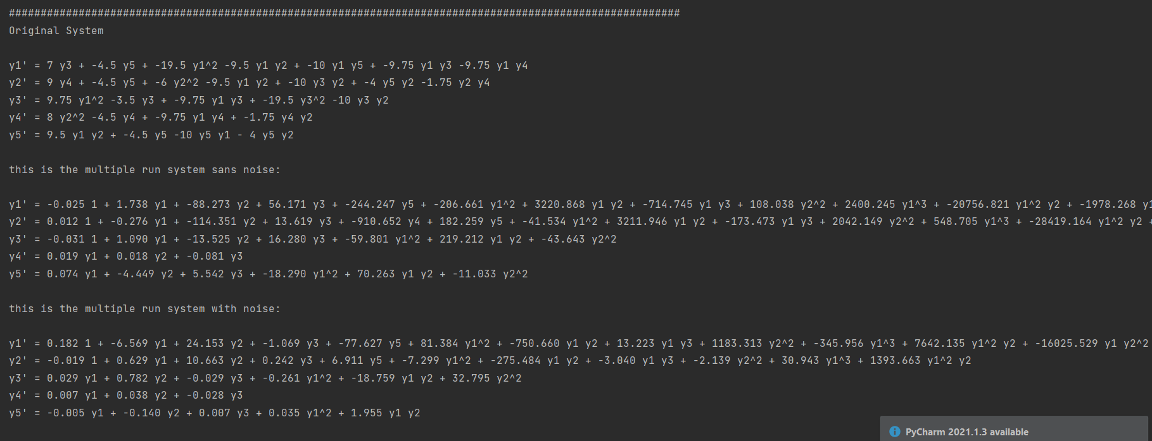
1 run

Slide 3
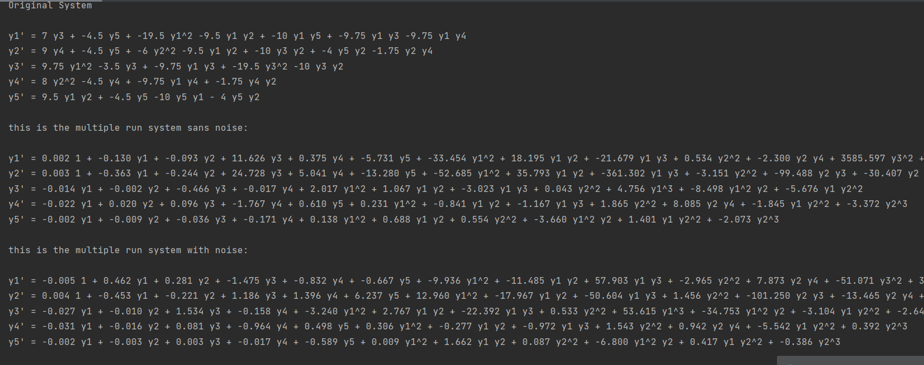
10 run

Slide 4
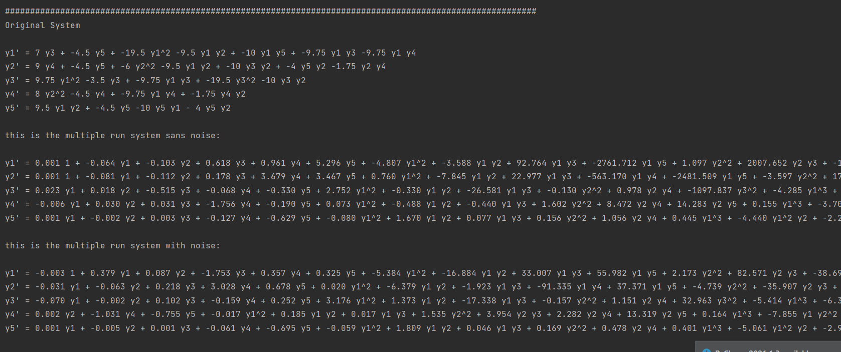
100 run

